Slide 1
Creation/Reviewer team
Techsquad
Yassine B
Sylvain P
Fanilo A
Vijay P
Mat Goodger & Effan Mutembo
Yacine Kessaci & Cyril Cauchois
Liyun He Guelton & Jamal EDDINE Shri
Julien Terruel

Slide 2
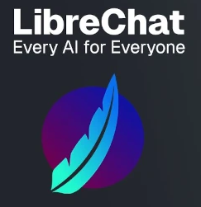








Content
https://worldline.github.io/learning-ai/
Definitions ( LLM, MMLLM, ML, DL, NN…)
Prompting
General ( frameworks: chain of thought)
For Devs ( test, refactor…)
Online / Offline with Librechat / LM Studio
Presets
Plugin / Mixing
RAG
Develop with genAI (Copilot/V0)
GenAI for services
Dialog with LLMs
API / Json mode / Structured Output
Context aware frameworks
RAG for services
structured / unstructured
Cloud AI / Manage models

Slide 3







How to ?
https://github.com/worldline/learning-ai
https://worldline.github.io/learning-ai/
https://vscode.dev/github/worldline/learning-ai
- CI
- Pages

